Slide 1
Introduction to Tableau

Slide 2
Tableau is an interactive, self-service reporting and and analyzing tool that enables people to combine the data from different sources into visualisations and to be accesses in a single desktop environment utilizing Tableau Desktop or through a common dashboard. Tableau is one of the such leading business intelligence tool to move your business speedier and make it simple to-comprehend by clients and customers. With high scalable, effectively deployable and efficient performing business system. Enterprises are investing millions in this BI tool to compete in the data analytics race and stay as a business pioneer in the market.

Slide 3

Business Intelligence is a set of processes, architectures and technologies or tools that convert raw data into meaningful, presentable report or information.
Business Intelligence combines business analytics, data mining, data visualization, data tools and infrastructure and best practices to help organizations to make data-driven decisions

Slide 4
The real advantage of Tableau is its capacity to investigate any data of any size by a simple drag and drop interface. You can utilize Tableau’s drag and drop interface to visualize any data, investigate distinctive perspectives, and even combine various databases effectively. It doesn’t require any complex scripting. Any individual who understands the business issues can address it

Slide 5
Tableau was founded in 2003 as a result of a computer science project at Stanford that aimed to improve the flow of analysis and make data more accessible to people through visualization. Co-founders Chris Stolte, Pat Hanrahan, and Christian Chabot developed and patented Tableau's foundational technology, VizQL—which visually expresses data by translating drag-and-drop actions into data queries through an intuitive interface

Slide 6
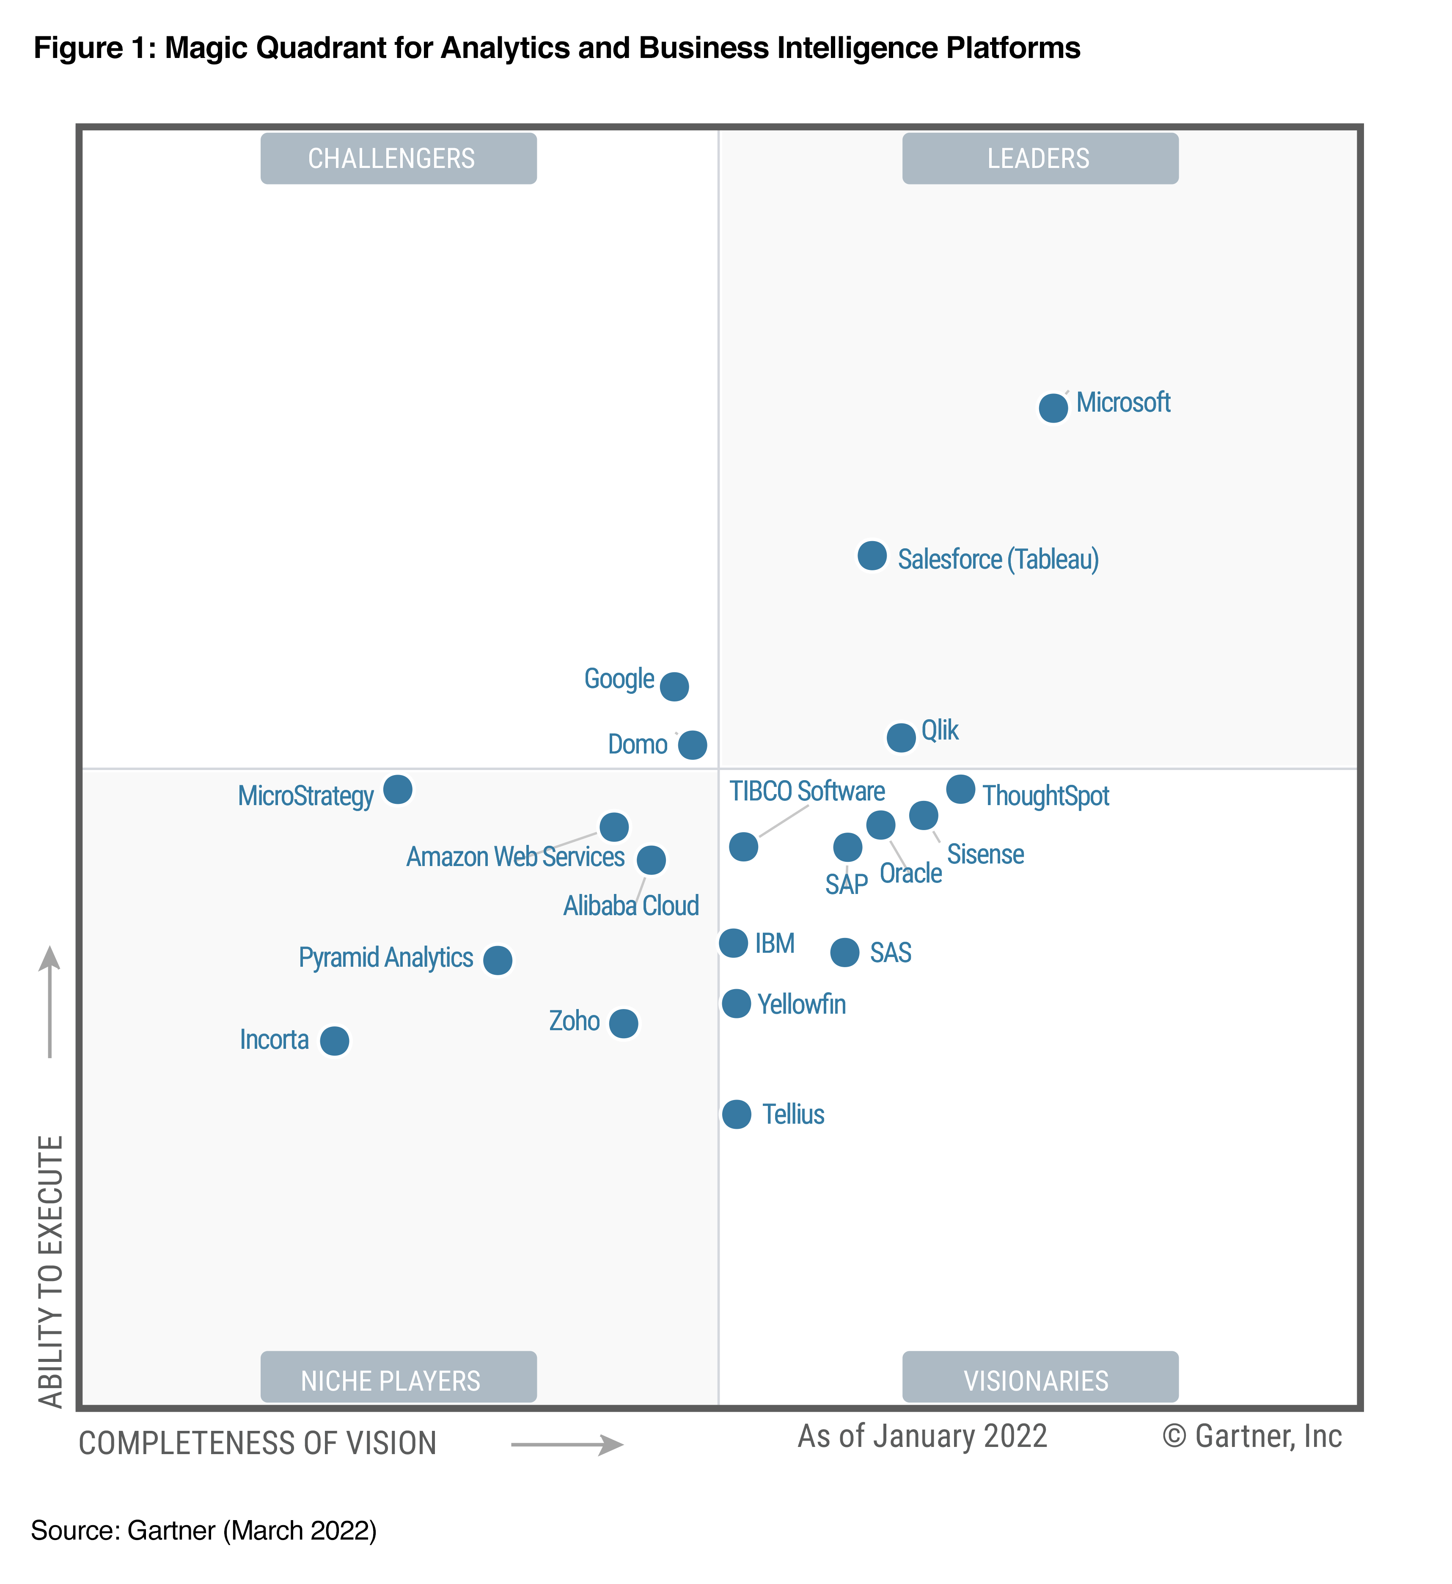

Slide 7
Tableau Architecture
Tableau has a high scale-able, n-tier client server architecture that serves mobile user, web users and desktop- installed software. It gives an adaptable solution for creation and analysis of web, portable and desktop analysis. Tableau Desktop is the authorizing and publishing tool that is utilized to create shared views on Tableau Server.

Slide 8
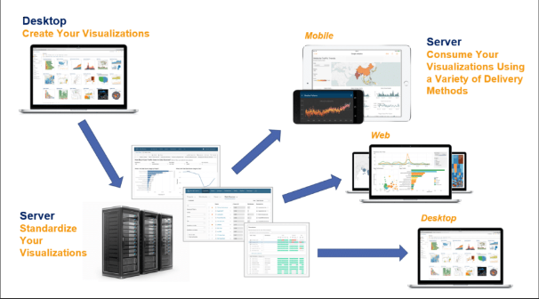

Slide 9
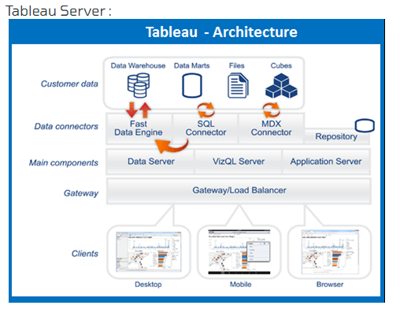
It is an enterprise business platform. It can set up a huge number of clients. Offers powerful mobiles and web based analytics works with companies existing information and security protocol.

Slide 10
Data Layer :
The basic characteristic of tableau that supports your selection of data architecture. Tableau does not require any limitations for the database like data to be stored in any single system. The vast majority of the organizations have a heterogeneous environment. Tableau can work with all these simultaneously. Tableau gives simple alternatives to update your data to be quick and responsive with our quick in-memory Data Engine.

Slide 11
Data Connectors:
Tableau includes various connectors for databases, for example, Microsoft Excel, SQL Server, Oracle, Teradata, Vertica, Cloudera Hadoop, and significantly more. There is additionally a non specific ODBC (Open Data Base Connectivity) connector for any frameworks without a local connector. Hence, tableau gives two modes to collaborating with data : Live connection or In-memory. Clients can switch between a live and in-memory association as they choose.

Slide 12
Live Connection :
Tableau data connectors use your current information by sending dynamic SQL or MDX (Multidimensional Expressions) statements directly to the source database rather than importing all the data. On the off chance that you need to fastely import every one of the information then you can take live association. Also, this implies Tableau can successfully use boundless measures of data – indeed, Tableau is the front-end analytics client to a considerable lot of the biggest databases in the world. Therefore tableau has optimized every connector to take advantage of unique characteristics of each data source.

Slide 13
In- Memory :
Tableau offers quick analytic performance due to in-memory data engine. You can connect with any information, with a single tick; data will extract the data and get its memory in the tableau. Engine used your whole system to get the quick reaction on millions of lines of data. Data engine can access the disc store and in addition RAM and reserve memory.

Slide 14
Types of Tableau Products
Tableau has many products, it is categorised based on the nature of their functionality. The server part, the developer part, the viewer part and data preparation part

Slide 15
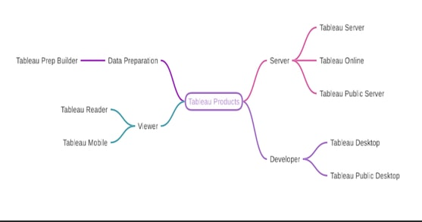

Slide 16
Server Part
1. Tableau Server
Tableau Server is a paid Server application which needs to be installed on a Windows or Linux server. This is used widely in the enterprise world. Usually there would be a dedicated admin team/person to take care of the memory, user management, data source management , folder management and other server related things.

Slide 17
Tableau Online
Tableau online is a paid server application too but it is already hosted by Tableau software and so no need to install on any windows server. It is better when you need the Tableau dashboards to be accessed from anywhere. It has almost all features of Tableau server but on the internet.

Slide 18
Tableau Public Server
Tableau Public server is a free server in the internet. This is the YouTube or Blogspot in Tableau Data Visualisation world. It is free and people post their ideas and visualisation here. We call it the Visual blog. It has no user management or folder management options. You can hide your work though. It cannot have live data source but only Extract. So many people publish their ideas and custom visualisations here. We could find the inspiration from here.

Slide 19
Developer Part
Tableau Desktop
Tableau Desktop is a paid desktop application. It is also called as Tableau Desktop Professional edition. This is where the developers create charts, formula, dashboards, actions and everything. It has 14 days trial too. The dashboards we create here can be published to any Server listed above. It can be opened in Tableau reader. Read Tableau reader for more information.

Slide 20
Tableau Public Desktop
Tableau Public Desktop is a free desktop application. It is the developer place for Tableau Public server. It is free and has some limitations like cloud Save only, no live or database connection. They are widely use by learners, bloggers, public information related institutions like the media, etc.

Slide 21
Viewer Part
Tableau Reader
Tableau Reader is the free desktop application which can help us to view the Tableau dashbords created by Tableau Desktop. It supports only extract connection files. It can help new people to try Tableau by getting one license for Tableau Desktop and installing this free software on their end user’s machine. It can open the dashboards, interact with them like filtering, tooltip and parameters. We cannot edit the formula or charts here.

Slide 22
Tableau Mobile
Tableau mobile is a mobile application. It is available in iOS and Android. It can connect to Tableau server or Tableau online. It is just like Tableau Reader buy for mobile. It can help to interact and view dashboards which are published to Tableau server or Tableau online.

Slide 23
Data Preparation Part
1. Tableau Prep builder
Tableau Prep builder is a new product of Tableau. It helps developers to cleanse, blend and wrangle the raw data. It is a mini ETL ( Extraction, Transformation and Loading ) tool which can connect to different database, join the data, transformation over the data and save the file as output. It can be automated and help developers to avoid redundant manual data manipulation.

Slide 24
Tableau Shelf and Cards
Every worksheet in Tableau contains shelves and cards, such as Columns, Rows, Marks, Filters, Pages, Legends, and more.
By placing fields on shelves or cards, you:
Build the structure of your visualization.
Increase the level of detail and control the number of marks in the view by including or excluding data.
Add context to the visualization by encoding marks with color, size, shape, text, and detail.
Experiment with placing fields on different shelves and cards to find the optimal way to look at your data.

Slide 25
Columns and Rows shelves
Drag fields from the Data pane to create the structure for your visualizations.
The Columns shelf creates the columns of a table, while the Rows shelf creates the rows of a table. You can place any number of fields on these shelves.
When you place a dimension on the Rows or Columns shelves, headers for the members of that dimension are created. When you place a measure on the Rows or Columns shelf, quantitative axes for that measure are created. As you add more fields to the view, additional headers and axes are included in the table and you get an increasingly detailed picture of your data.
In the view shown below, the members of the Segment dimension are displayed as column headers, while the Profit measure is displayed as a vertical axis.

Slide 26
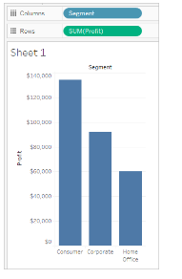

Slide 27
Tableau displays data using marks, where every mark corresponds to a row (or a group of rows) in your data source. The inner fields on the Rows and Columns shelves determine the default mark type. For example, if the inner fields are a measure and a dimension, the default mark type is a bar. You can manually select a different mark type using the Marks card drop-down menu

Slide 28
Pages shelf
The Pages shelf lets you break a view into a series of pages so you can better analyze how a specific field affects the rest of the data in a view. When you place a dimension on the Pages shelf you are adding a new row for each member in the dimension. When you place a measure on
the Pages shelf, Tableau automatically converts the measure into a discrete measure.

Slide 29
The Pages shelf creates a set of pages, with a different view on each page. Each view is based on a member of the field you placed on the Pages shelf. You can easily flip through the views and compare them on a common axis, using the controls that get added to the view when you move a field to the Pages shelf. For example, the view below shows the Profit vs. Sales by Region for each day throughout the month. The image below shows days 1, 2, 3, and 4. You would have to scroll down to see other days in the month.

Slide 30
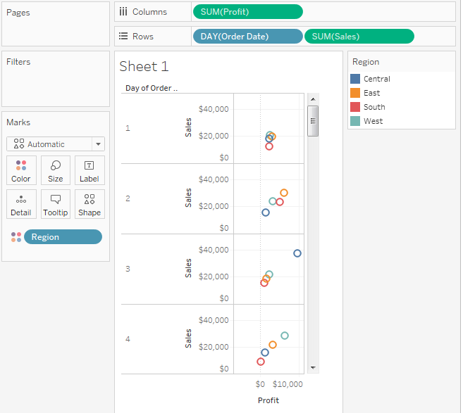

Slide 31
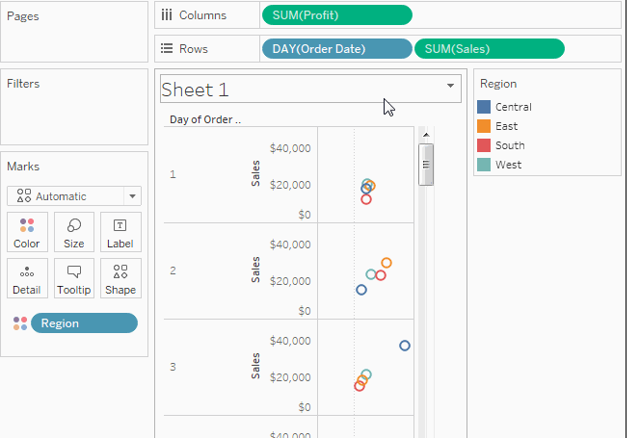
To make this view more user-friendly, move DAY(Order Date) to the Pages shelf and use the associated control to flip through the pages (one for each day). You can quickly discover hidden insights. In this example, it is interesting that the 19th is an especially big day in terms of sales and profit in the Western region.

Slide 32
When you add a field to the Pages shelf, a page control is automatically added to the right of your view.
Use this control to navigate through the pages. There are three ways to navigate through the pages in a view:
Jump to a specific page
Manually advance through the pages
Automatically advance through pages

Slide 33
Filters shelf
The Filters shelf allows you to specify which data to include and exclude. For example, you might want to analyze the profit for each customer segment, but only for certain shipping containers and delivery times. By placing fields on the Filters shelf, you can create such a view.
You can filter data using measures, dimensions, or both at the same time. Additionally, you can filter data based on the fields that make up the columns and rows of the table. This is called an internal filter. You can also filter data using fields that don’t contribute headers or axes to the table. This is called an external filter. All filtered fields display on the Filters shelf.

Slide 34
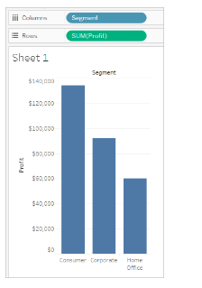
To illustrate the basic concepts of filtering, consider the following view.

Slide 35
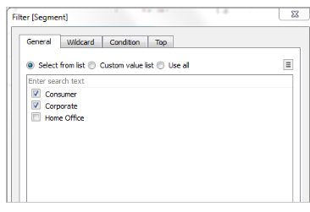
Suppose you are not interested in the Home Office data. You can remove this column from the view by filtering the Segment dimension. To do so, select Filter on the field menu or drag
the Segment dimension to the Filters shelf. The Filter dialog box opens. By default all members are selected. Clear the check box for Home Office to exclude it from the view. All selected members will be included.

Slide 36
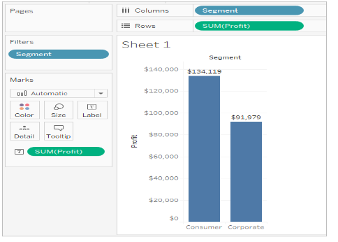
As shown below, the view updates and the Home Office column is removed. The filter is indicated by the Segment field on the Filters shelf.

Slide 37
Suppose you want to only view profit for a category of the products. Even though the Category field is not used on the Rows and Columns shelves or on the Marks card, you can still add a filter. Drag the Category dimension to the Filters shelf. This is an example of an external filter because Category is not part of the view.
The Filter dialog box automatically opens. By default, none of the members are selected. Select the members you want to keep as part of the view. All cleared members are excluded. In this example, Office Supplies is selected.
The modified data view is shown below. The mark label shows that the sum of the profit for the Consumer segment has decreased to $56,330. This number is derived by summing all the rows in the data source that are associated with the Corporate market and are part of the Office Supplies category.

Slide 38
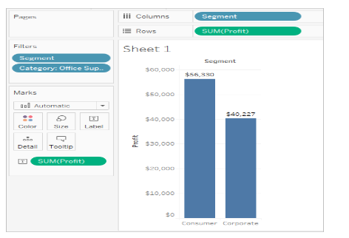

Slide 39
The order of fields placed on the Filters shelf does not affect the data view because the filters are independent. In other words, the result of filtering by customer segment, and then by container is the same as filtering by container and then by customer segment.

Slide 40
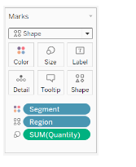
Marks card
The Marks card is a key element for visual analysis in Tableau. As you drag fields to different properties in the Marks card, you add context and detail to the marks in the view.
You use the Marks card to set the mark type (see Change the Type of Mark in the View), and to encode your data with color, size, shape, text, and detail.

Slide 41
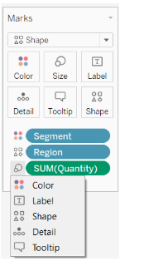
In this example, three different fields have been dragged to different properties in the Marks card. Segment is on Color, Region is on Shape, and Quantity is on Size.
After you add a field to the Marks card, you can click the icon next to the field to change the property it is using. You can also click the property buttons in the Marks card to change those settings.

Slide 42
Many properties can have multiple fields. For example, you can add multiple fields to Label, Detail, Tooltip, and Color. Size and Shape can only have one field at a time.

